Slide 1

Pupil Premium

Slide 2
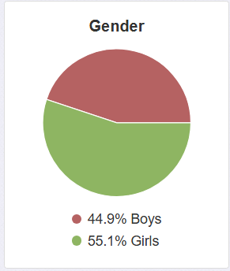
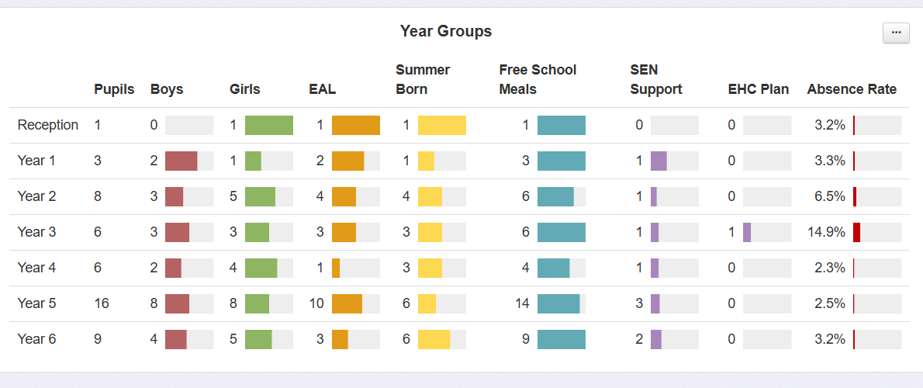
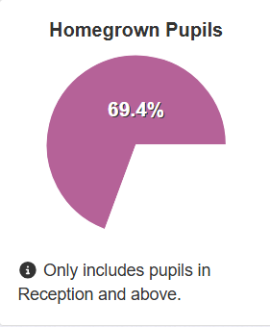
49 Pupil Premium Pupils
43 FSM
1 service child
7 PLAC
1 LAC

Slide 3

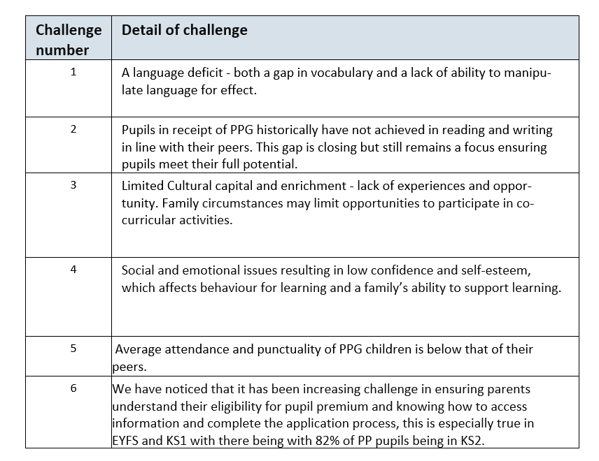




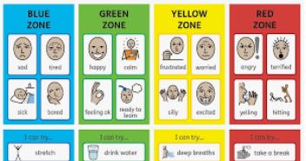

PP Strategy and Provision at OLQOH
Tutoring
Activities Week
Green Card
Summer Trips
School responsibilities
Easter School
WPA

Slide 4



SALT Support
NHS
Private therapist (Spring Term)
Weekly Makaton sign
Word Aware used across the school
1) Language Deficit

Slide 5
2)Reading and Writing
Targeted interventions
New Spelling Scheme for KS2
Tutoring
Provision Map Monitoring
Pupil Progress Meetings
Adaptive Teaching CPD for teaching staff
Locality and Trust Moderation
CPD for staff- specific subjects along with pedagogy

Slide 6
End of Year Data 2024-2025
% of PP pupils achieving ARE or above
 | Year 1 | Year 2 | Year 3 | Year 4 | Year 5
Reading | 50% | 25% | 75% | 67% | 89%
Writing | 33% | 25% | 75% | 67% | 67%
Maths | 33% | 25% | 50% | 75% | 89%
Historically, Pupil Premium pupils have performed better in Mathematics than in Literacy. However, last year, that gap has narrowed, with some year groups PP pupils now achieving higher outcomes in Literacy than in Maths, this is especially true in KS1 and lower KS2 where there is a high focus on language development. This shift highlights the success of the school’s focused efforts to raise literacy attainment among disadvantaged pupils.

Slide 7
3)Cultural capital
Green cards
Engaging and meaningful curriculum enhancements- trips, events
Activities week
PP children in roles of responsibility- School council, Art ambassadors, Science Leaders
3 Before Me- promoting independence
Targeted clubs and workshops
Club tracking – Reminders to parents about the Green Card initiative and encouragement to sign up for clubs.

Slide 8
4) Social and emotional
ELSA Support
Play Therapy
SALT Therapy
Educational Psychologist
Sign posting parents – Early Help
Learning Mentor Support
Attendance – EWO
New School Reward system

Slide 9
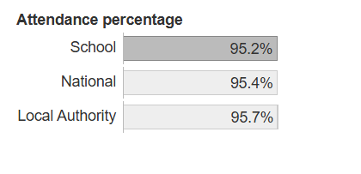
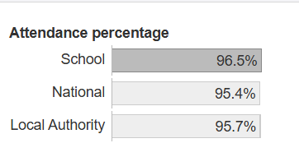
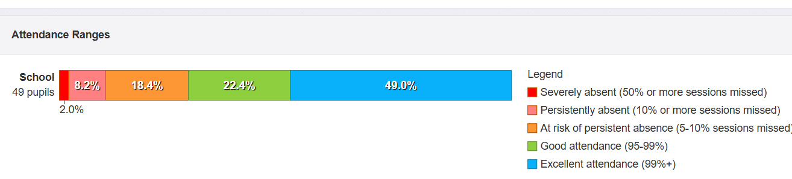
5) Attendance
Non PP Pupils
PP Pupils
Daily attendance list sent to teaching staff
Letters sent home
Meetings with parents
Targeted Support/ Reduced timetable
BOSCO Network Group
WPA support

Slide 10
Sign up for FSM funding
Letters and Parent Mail information
Green Card Initiative
Consider priority booking for clubs/ parent meeting slots

